Slide 1
Candy Web Browser
Using Python
Submitted By
Prachi Agrawal
Neha Arya
Ritika Brewal
(BTech, CSE, 3rd year)
Mentor
Mandeep Singh(MCTS)
Technical Trainer
Computer Engineering and Applications
GLA University, Mathura

Slide 2
Introduction
A Candy is a software program that allows you to access the internet and all the web pages in it.
Most common browsers are Google Chrome, Microsoft Edge, Brave, Firefox, and Safari, and you are most definitely reading this article in one of these.
This project is a tutorial demonstrating the capabilities of the web platform on Windows 10. The browser is a sample app built around the using primarily python PYQt5 module. Built using Visual Studio 2015.

Slide 3




Technologies and Modules used
Python
PyQt5 Module
HTML/CSS

Slide 4
PyQt5 Module
There are so many options provided by Python to develop GUI application and PyQt5 is one of them. PyQt5 is cross-platform GUI toolkit, a set of python bindings for Qt v5. One can develop an interactive desktop application with so much ease because of the tools and simplicity provided by this library.
A GUI application consists of Front-end and Back-end. PyQt5 has provided a tool called ‘QtDesigner’ to design the front-end by drag and drop method so that development can become faster and one can give more time on back-end stuff.

Slide 5
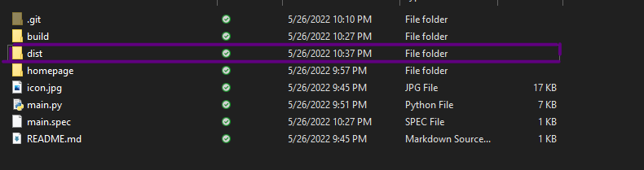
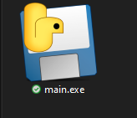
How to run application in your system
To run the appliaction on your system, download the exe file which is inside dist folder and run it.
One do not need to install python or any python module.

Slide 6
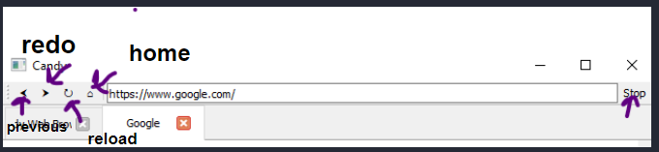
Functionality
Search on home page
Open new tab by double clicking on statusbar
Back to home page by clicking on home icon
Move to previous page by clicking on left arrow icon
Redo to page by clicking on right arrow icon
Use rounded arrow to reload
Use stop button to stop loading

Slide 7
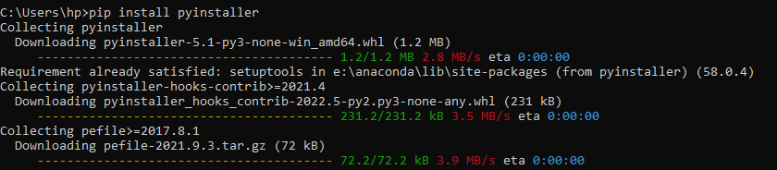
Converting python file to executable
This has been done using another python modules
Pyinstaller
Steps:
Open command prompt
Run pip install pyinstaller
Move to the folder where main.py is store
Run command- pyinstaller -F -w main.py

Slide 8
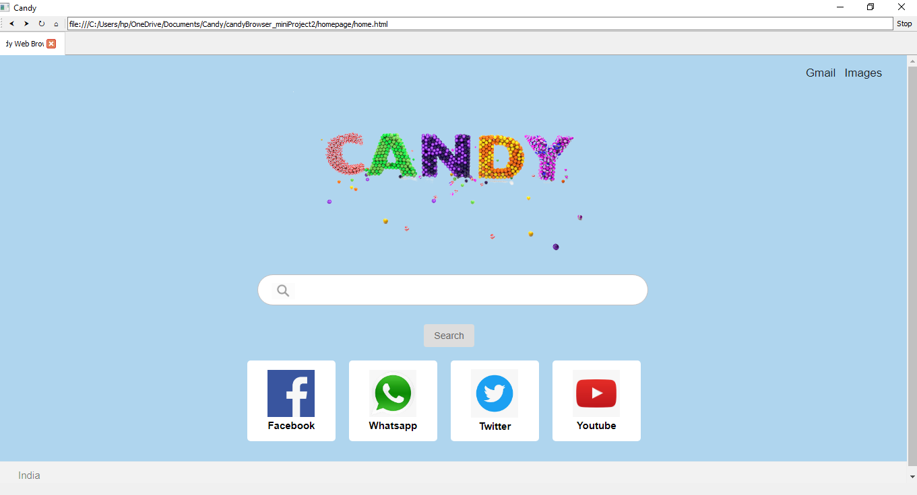
First View

Slide 9
Future Planning
In future, we are planning to add functionality using which one can control browser search using hand gesture.
For that user have to set, which site to open with which gesture.
For example- using 2 fingers, one want to opne youtube
Using 3 fingers , open google

Slide 10
Link to our project
prachi0011/candyBrowser_miniProject2 (github.com)

Slide 11
Thank you!

